Slide 1
Using Non-invasive brain stimulation to modulate suprAspinal circuits after sci
Jennifer Iddings, PhD & Anastasia Zarkou, PT, PhD
Postdoctoral Research Fellows
Crawford Research Institute
SCI Research Laboratory

Slide 2
Non-Invasive Brain Stimulation (NIBS)
Two primary classifications of NIBS modalities:
Transcranial magnetic stimulation (TMS)
Neurophysiology measure: single & paired pulse TMS
Neuromodulation tool: repetitive TMS (rTMS), paired associative stimulation (PAS),
Transcranial current stimulation (tCS)
direct (tDCS)
pulsed (tPCS)
alternating (tACS)
random noise (tRNS)

Slide 3
Non-Invasive Brain Stimulation (NIBS)
Two primary classifications of NIBS modalities:
Transcranial magnetic stimulation (TMS)
Neurophysiology measure: single & paired pulse TMS
Neuromodulation tool: repetitive TMS (rTMS), paired associative stimulation (PAS)
Transcranial current stimulation (tCS)
direct (tDCS)
pulsed (tPCS)
alternating (tACS)
random noise (tRNS)

Slide 4
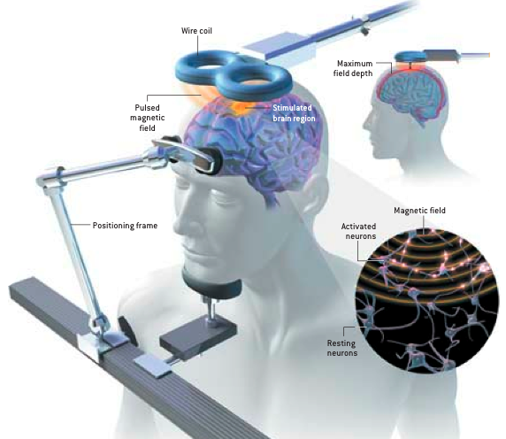
Basic Principles of TMS
Electrical current in coil generates magnetic field
brain
Magnetic field passes through the skull unimpeded
Alternating magnetic fields induce electrical current in brain
George, Sci Am, 2003

Slide 5
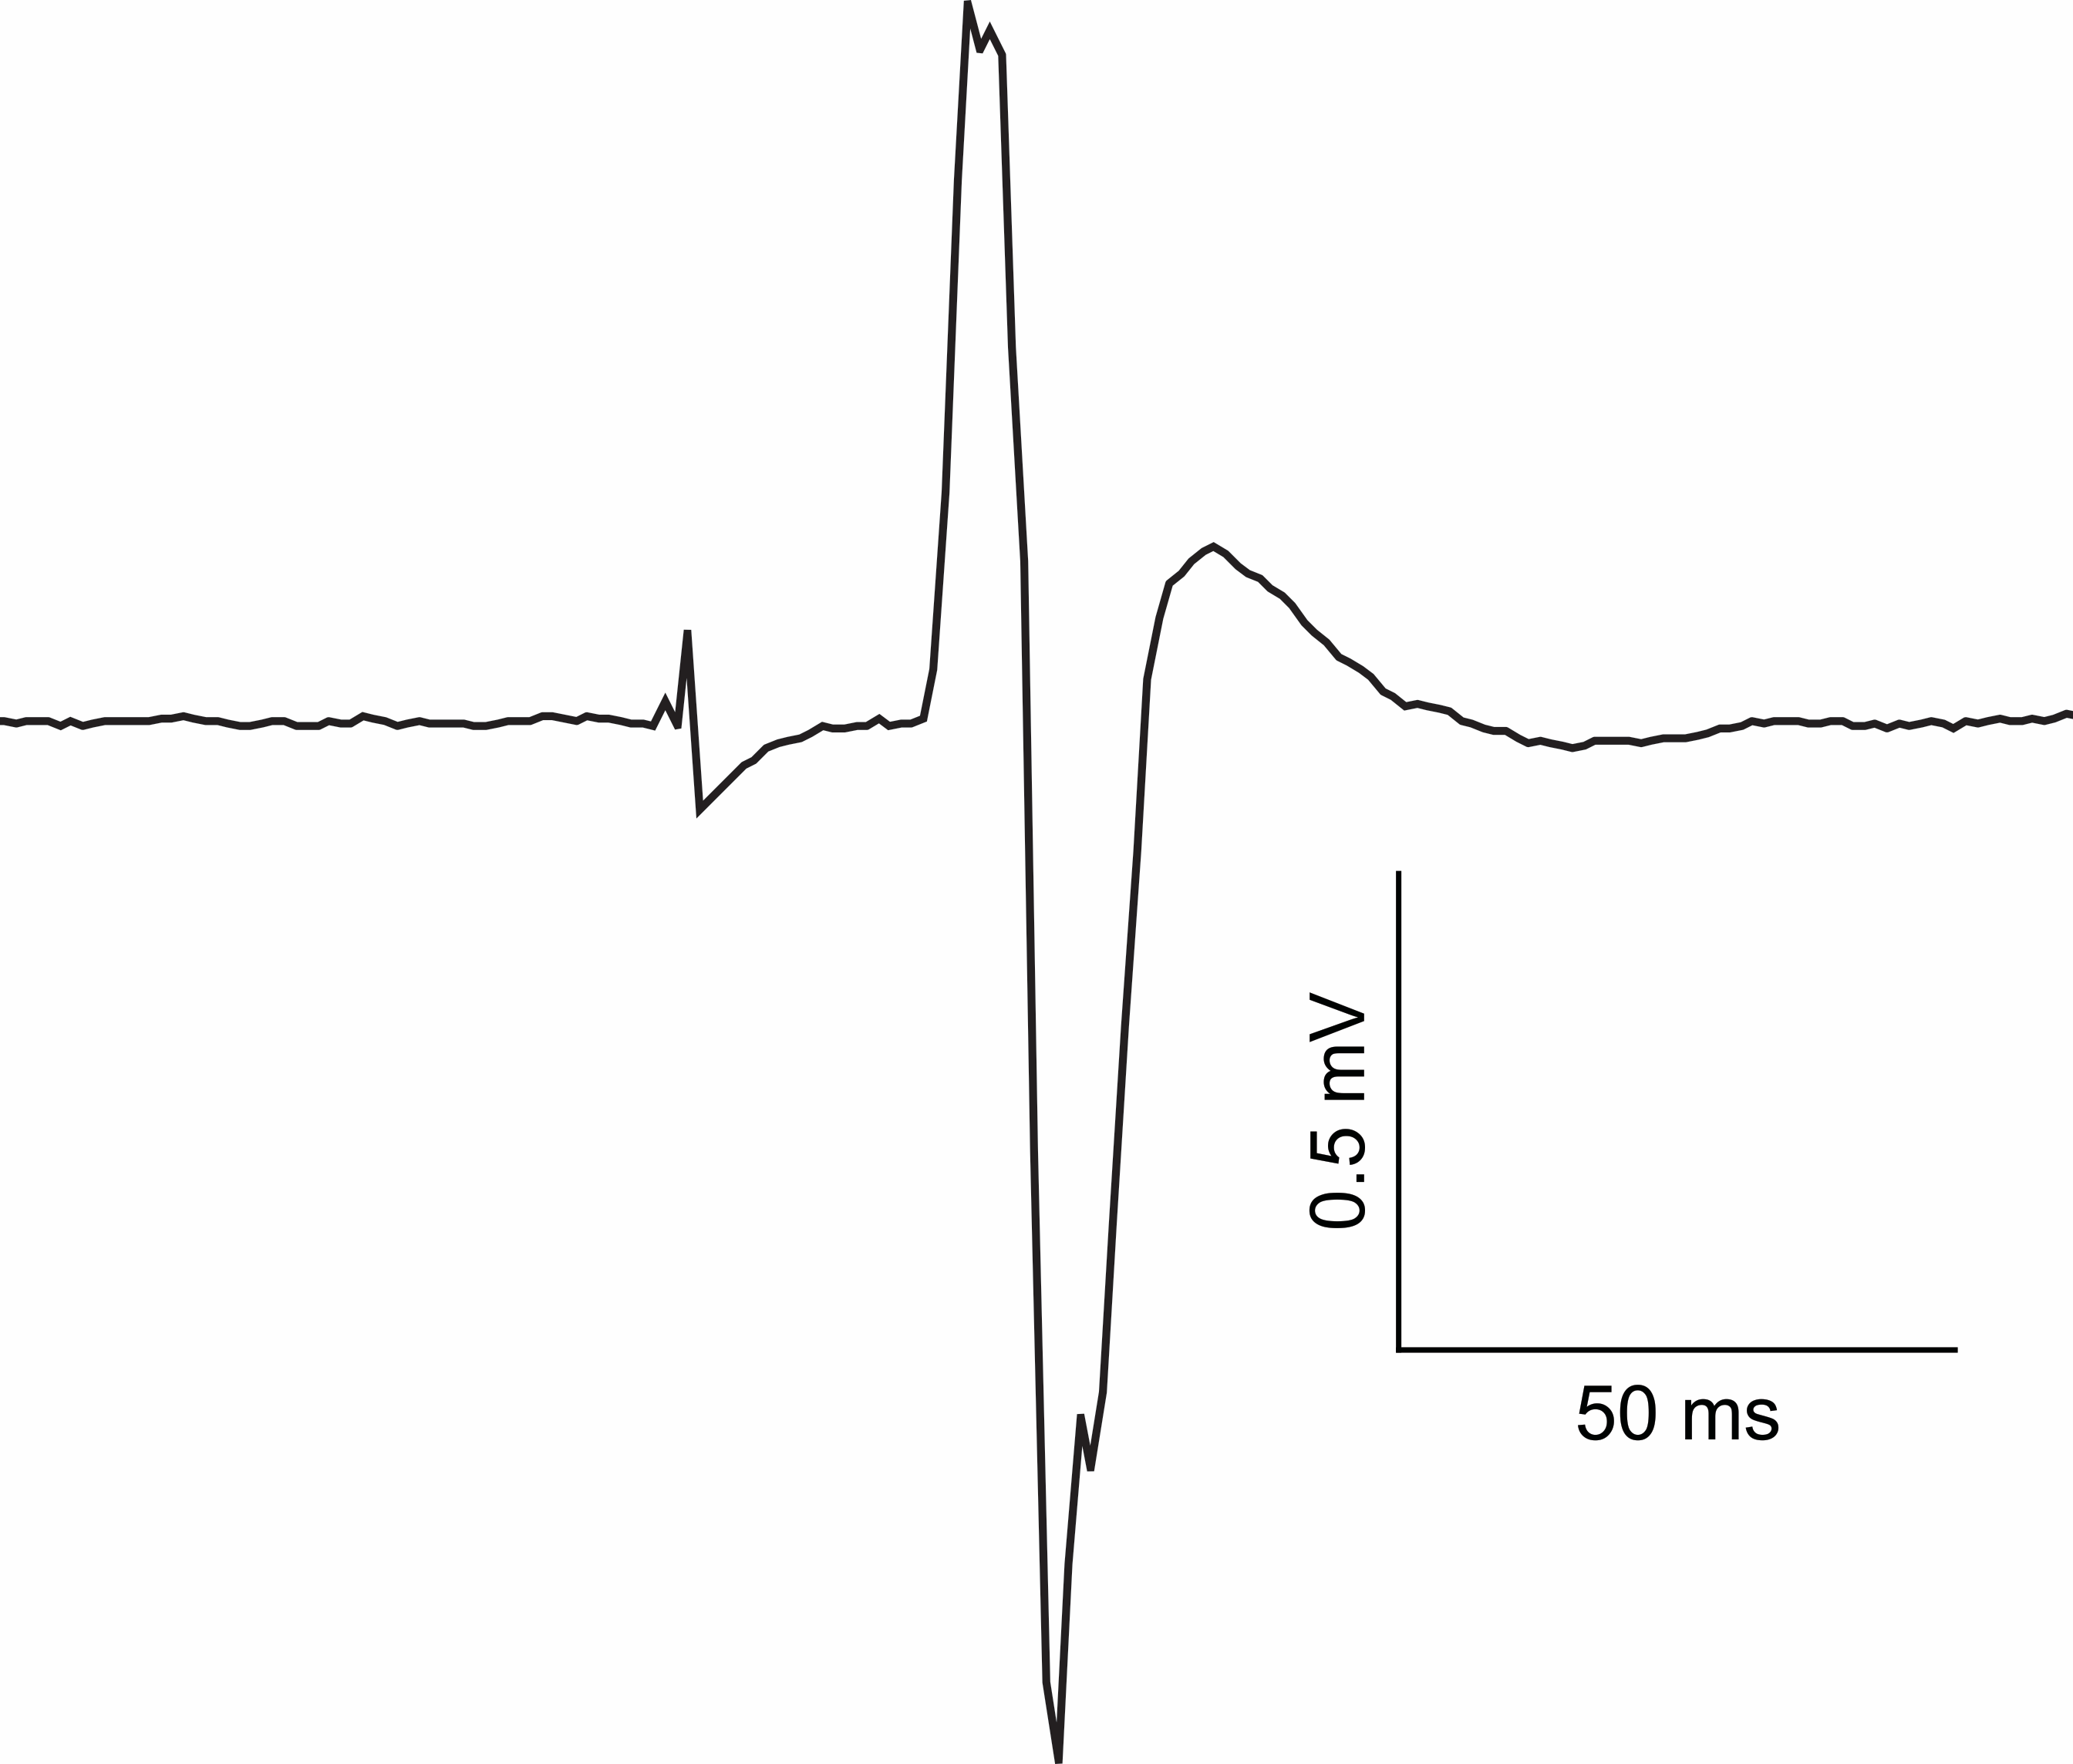
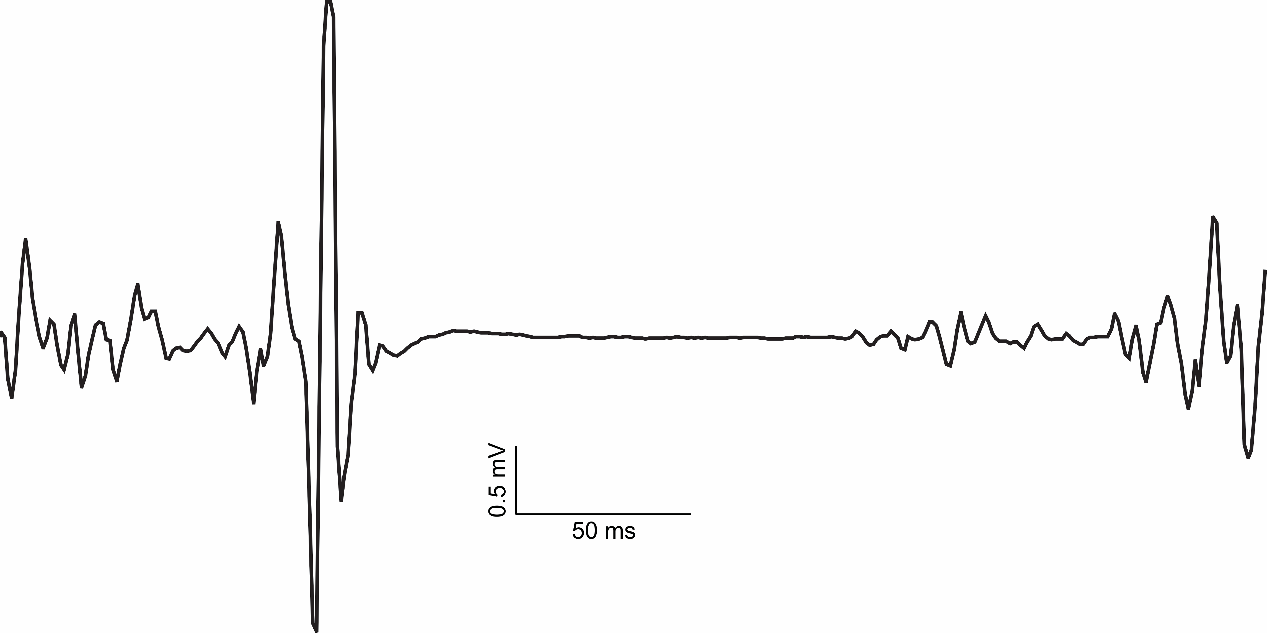
TMS as Neurophysiology Measure
Used to assess cortical & spinal circuitry
Suprathreshold stimulation of the motor cortex elicits muscle response - motor evoked potential (MEP)
Parameters of interest:
MEP amplitude
MEP latency
Silent period
Motor threshold (resting and active)
MEP latency
Resting MEP
MEP amplitude
Silent period
Active MEP

Slide 6
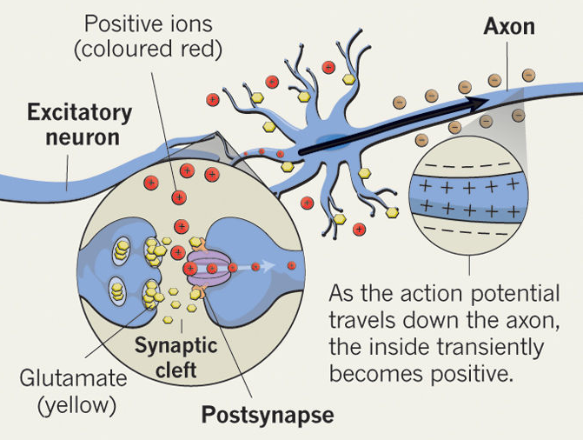
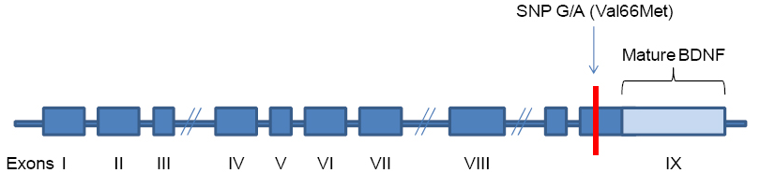
Basic Principles of rTMS
Sub- (or Supra-) threshold stimulation of targeted brain regions
Potential mechanisms:
Excitatory neurotransmitter receptor dependent
Brain derived neurotrophic factor (BDNF) genotype may dictate responsiveness
Modulation of cortical excitability is frequency dependent
Eisenstein, Nature, 2014
BDNF polymorphism
Morales-Marin et al., Neuropsychitr Dis Treat, 2016
Notes:
From Hoogendam et al: after cTBS and iTBS, MEPs were significantly changed in the Val/Val individuals but not in the non-Val/ Val individuals with one or two Met-alleles
Low frequency (≤ 2 Hz): inhibitory
High frequency (≥ 5 Hz): excitatory

Slide 7
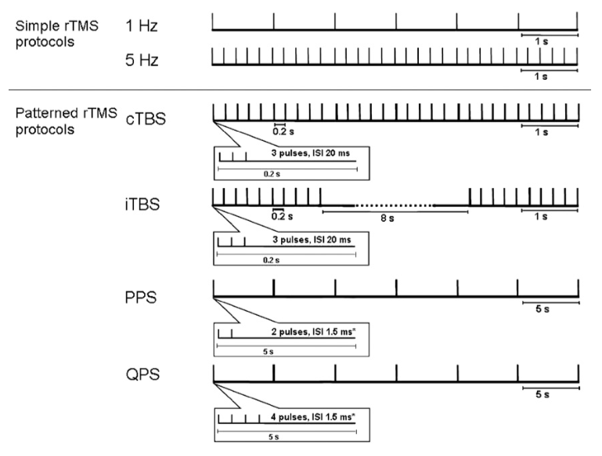
Basic Principles of rTMS
1. Standard rTMS:
Low frequency (≤ 2 Hz): inhibitory
High frequency (≥ 5 Hz): excitatory
2. Patterned rTMS:
Theta burst stimulation (TBS)
Continuous (cTBS): inhibitory
Intermittent (iTBS): excitatory
Repetitive paired pulse stimulation (PPS) and Quadripulse stimulation (QPS)
long interpulse intervals: inhibitory
short interpulse intervals: excitatory
Hoogendam et al., Brain Stimul, 2010
Notes:
ANIMATION
Repetitive paired pulse stimulation (PPS):
≥ 3 ms interpulse interval: inhibitory
1.5 ms interpulse interval: excitatory
Quadripulse stimulation (QPS):
≥ 30 ms interpulse interval: inhibitory
≤ 10 ms interpulse interval: excitatory
Both protocols repeated every 5 sec

Slide 8
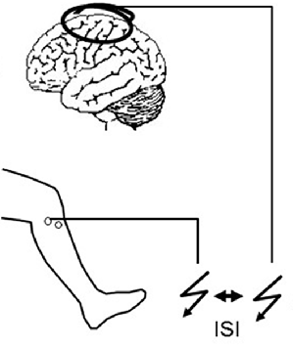
Basic Principles of PAS
Paired pulses of peripheral nerve stimulation + TMS
Potential mechanism:
Long-term potentiation/ depression of glutamatergic synapses
Modulation of cortical excitability is dependent upon inter-stimulus interval (ISI)
Suppa, Clin Neurophysiol, 2017
Kersting, Front Hum Neurosci, 2017
Suppa, Clin Neurophysiol, 2017

Slide 9
Non-Invasive Brain Stimulation (NIBS)
Two primary classifications of NIBS modalities:
Transcranial magnetic stimulation (TMS)
Neurophysiology measure: single & paired pulse TMS
Neuromodulation tool: repetitive TMS (rTMS), paired associative stimulation (PAS)
Transcranial current stimulation (tCS)
direct (tDCS)
pulsed (tPCS)
alternating (tACS)
random noise (tRNS)

Slide 10
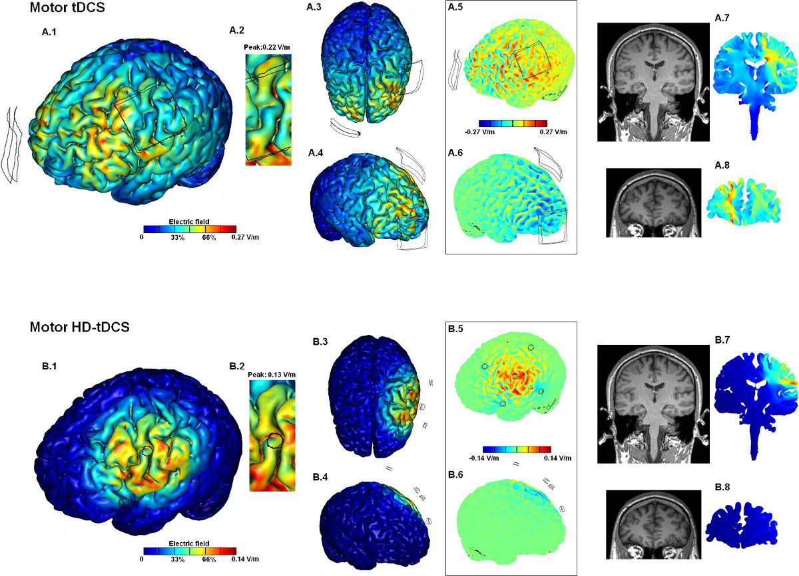
Basic Principles of tCS
Subthreshold stimulation modulating excitability of large brain regions
Does not elicit neuronal depolarization
Mechanism: modulation of neuronal resting excitability
Two categories:
Polarity dependent
Excitatory: anodal
Inhibitory: cathodal
Polarity independent
Excitation/inhibition are frequency and intensity dependent
Electrodes
Electrodes
Adapted from Villamar et al., J Vis Exp, 2013

Slide 11
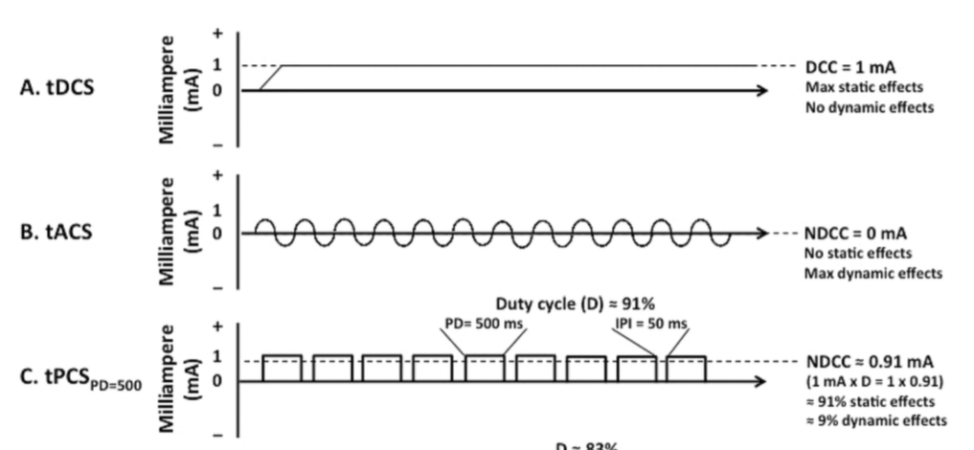
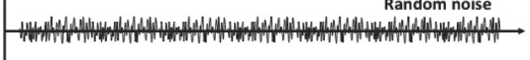
Basic Principles of tCS
After-Effect Modulation | tCS type | Waveform
Polarity Dependent | Direct: tDCS | monophasic, continuous
 | Pulsed: tPCS | monophasic, square
Polarity Independent | Alternating: tACS | biphasic, sinusoidal
 | Random Noise: tRNS | biphasic, random
Waveforms adapted from: Jaberzadeh & Zoghi, Basic Clin Neurosci, 2013; Jaberzadeh et al., PLOS One, 2015

Slide 12
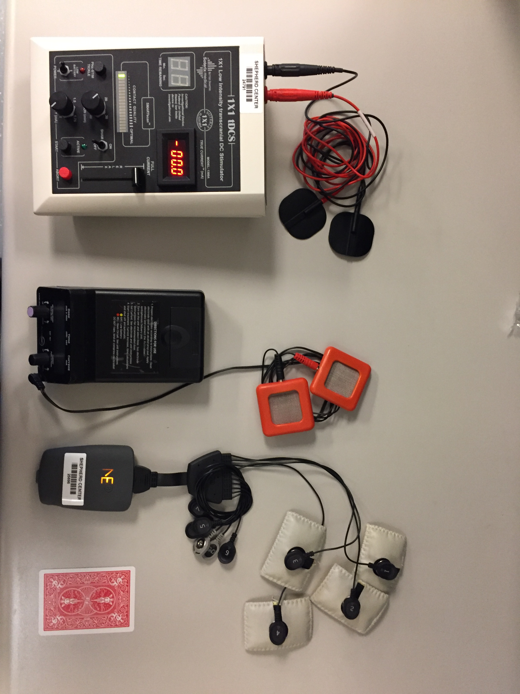
Application Basics of tCS
tDCS Devices
tCS Device
tDCS, tPCS, tACS, tRNS

Slide 13
Application Basics of tCS
Stimulation Parameters:
Current type: DC or AC
Intensity: < 4mA
Frequency: 0- 640Hz
Duration: < 60 min/ day
Ramp up/ down
Antal et al., Clin Neurophysiol, 2017; DaSilva et al., J Vis Exp, 2011; Woods et al., Clin Neurophysiol, 2016

Slide 14
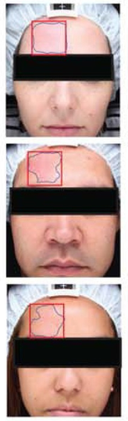
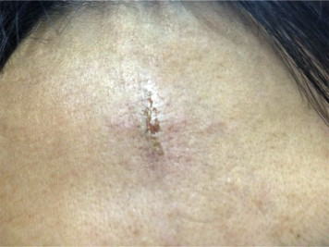
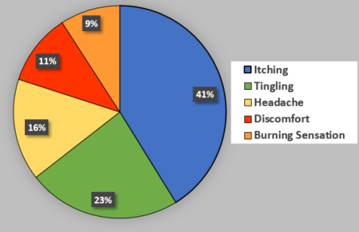
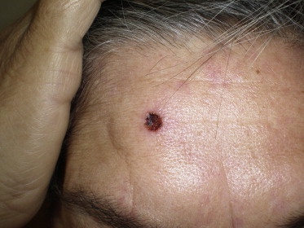
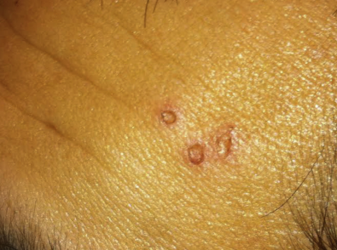
Application Basics of tCS
Stimulation Parameters
Adverse Effects:
Itching
Tingling
Headache
Discomfort
Burning Sensations
Skin redness
Mild fatigue
Skin burns
(Adapted from Wang et al., Brain Stimul, 2015)
(Adapted from Ezquerro et al., Neuromodulation, 2016)
Adapted from Palm et al., Brain Stimul, 2008)
(Adapted from Brunoni et al., Brain Stimul, 2011)
(Adapted from Neus et al., Brain Stimul, 2014)
Antal et al., Clin Neurophysiol, 2017; DaSilva et al., J Vis Exp, 2011; Woods et al., Clin Neurophysiol, 2016

Slide 15
Application Basics of tCS
Stimulation Parameters
Adverse Effects
Contraindications:
Implanted metallic device in the head
Uncontrolled seizures
Severe headache history
Scalp Lesions
Pregnancy
Pacemaker
Antal et al., Clin Neurophysiol, 2017; DaSilva et al., J Vis Exp, 2011; Woods et al., Clin Neurophysiol, 2016

Slide 16
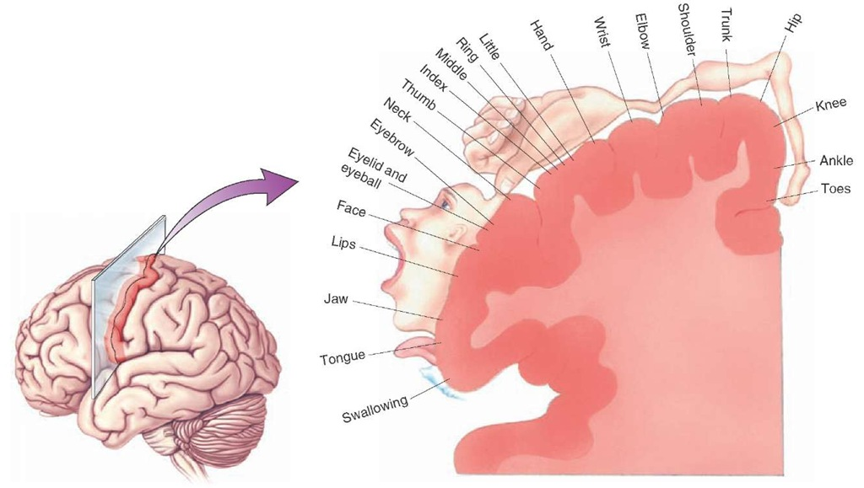
Application Basics of tCS:
Using Montages to Direct Effects
http://what-when-how.com/neuroscience/the-upper-motor-neurons-motor-systems-part-1/
Notes:
Somatotopic organization of motor cortex

Slide 17
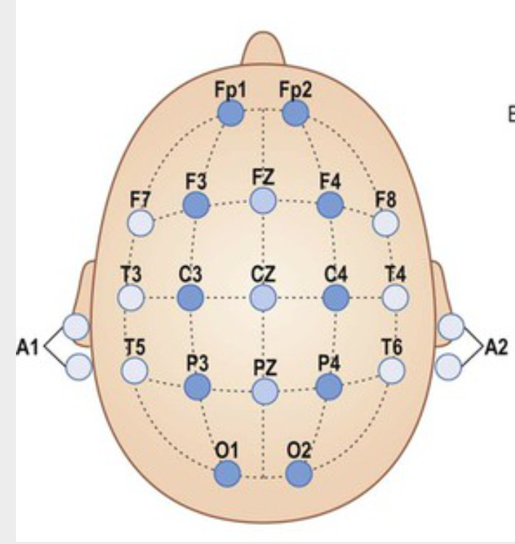
Application Basics of TCS:
Montages for Upper Extremity Neuromodulation
CATHODE
CATHODE
ANODE
ANODE
Left UE
Right UE
Adapted from www.clinicalgate.com/epilepsy-8

Slide 18
Application Basics of TCS:
Montages for Upper Extremity Neuromodulation
CATHODE
CATHODES
ANODE
ANODES
Both UEs
Adapted from www.clinicalgate.com/epilepsy-8

Slide 19
Application Basics of TCS:
Montage for Lower Extremity Neuromodualtion
ANODE
CATHODE
Adapted from www.clinicalgate.com/epilepsy-8

Slide 20
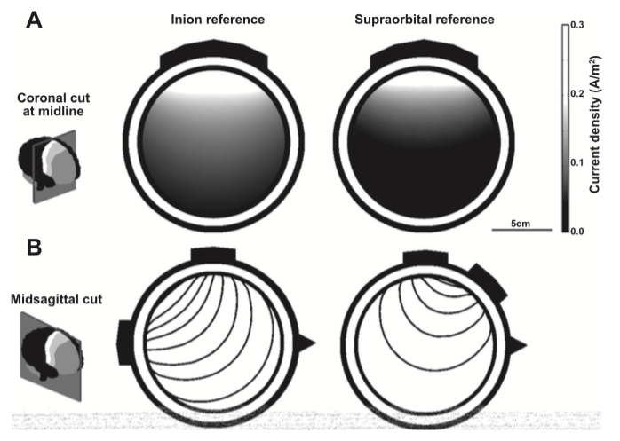
Application Basics of TCS:
Montage for Lower Extremity Neuromodualtion
ANODE
CATHODE
Kaski et al., J Neurophysiol, 2012
Adapted from www.clinicalgate.com/epilepsy-8

Slide 21
Advantages of tCS
 | tCS
Focality | Broad stimulation area
Cost | More affordable
Portability | Small footprint, easy to transport
Ease of Use | Easily applied
Application | Participant can move during stimulation

Slide 22
Advantages of tCS
 | rTMS | tCS
Focality | Specific stimulation area | Broad stimulation area
Cost | Expensive equipment | More affordable
Portability | Large and bulky | Small footprint, easy to transport
Ease of Use | Extensive training needed | Easily applied
Application | Participant in fixed position | Participant can move during stimulation

Slide 23
Non-Invasive Brain Stimulation in Persons with SCI

Slide 24
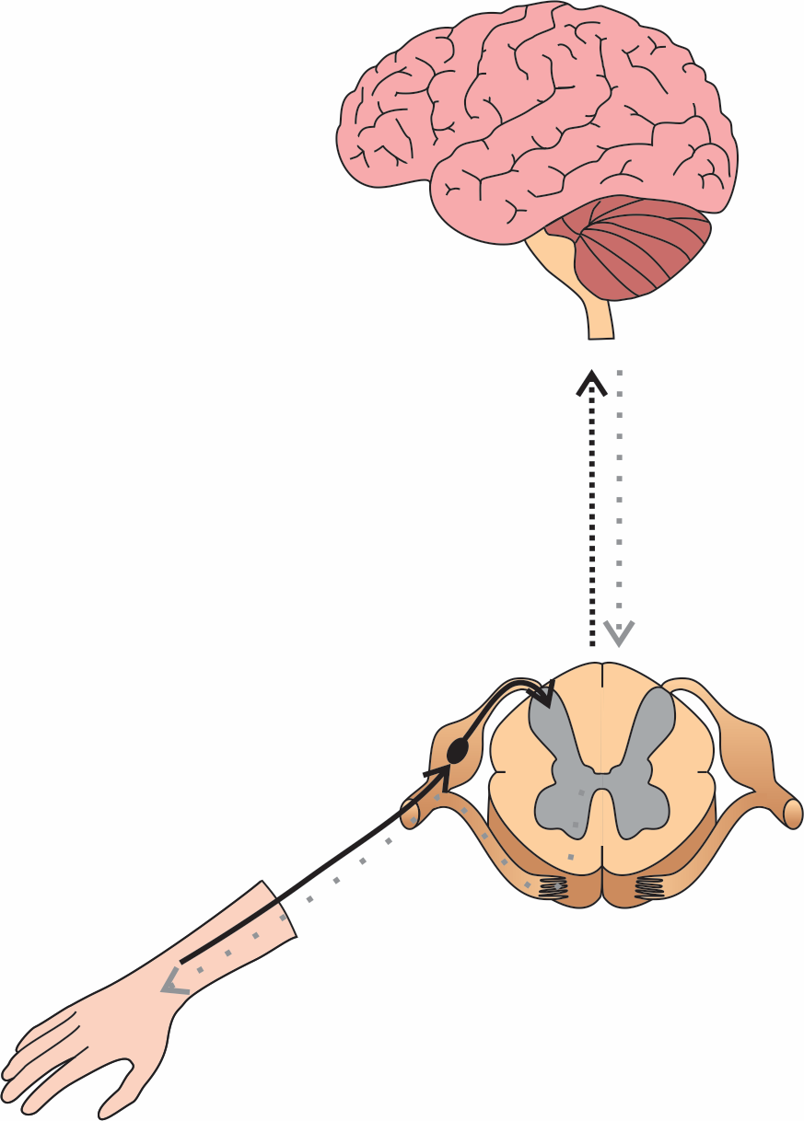
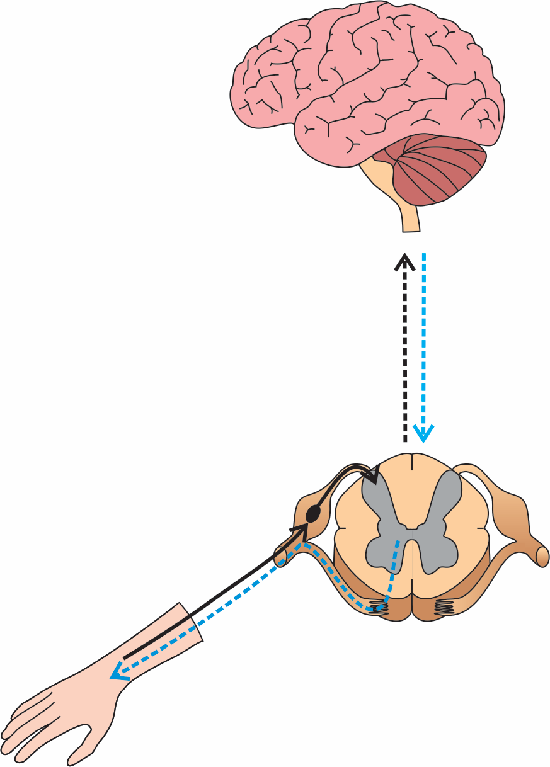
Maladaptive Cortical Plasticity Post-SCI: Reduced Motor Evoked Potential (MEP) Amplitude
Disruption of communication within the spinal cord
Decrease in cortical excitability
Disruption of communication within the spinal cord
Decrease in cortical excitability
2
1

Slide 25
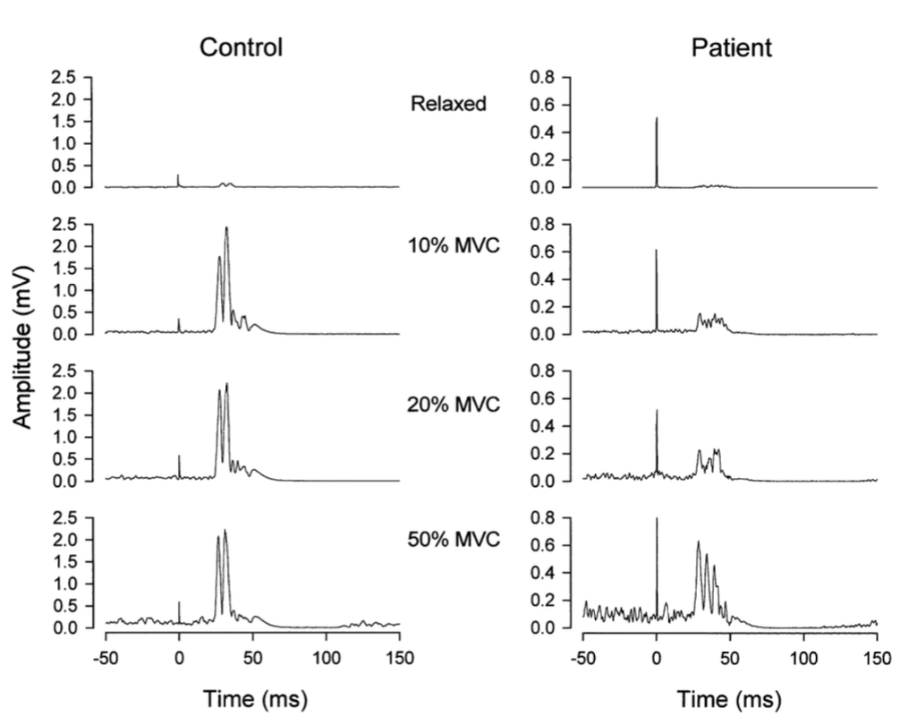
Maladaptive Cortical Plasticity Post-SCI: Reduced Motor Evoked Potential (MEP) Amplitude
Non-injured
Incomplete SCI
Davey et al., Exp Brain Res,1999
Notes:
Davey: Average rectified responses of thenar muscles to TMS at 1.1T evoked at four different voluntary contraction strengths in a control subject (different from the subject in Fig. 1) and a patient (Table 1, patient 8: AIS D, C7, 4 months post-injury). Each record is an average of between 10 and 20 responses. Note the more sensitive y-axis scaling in the patient

Slide 26
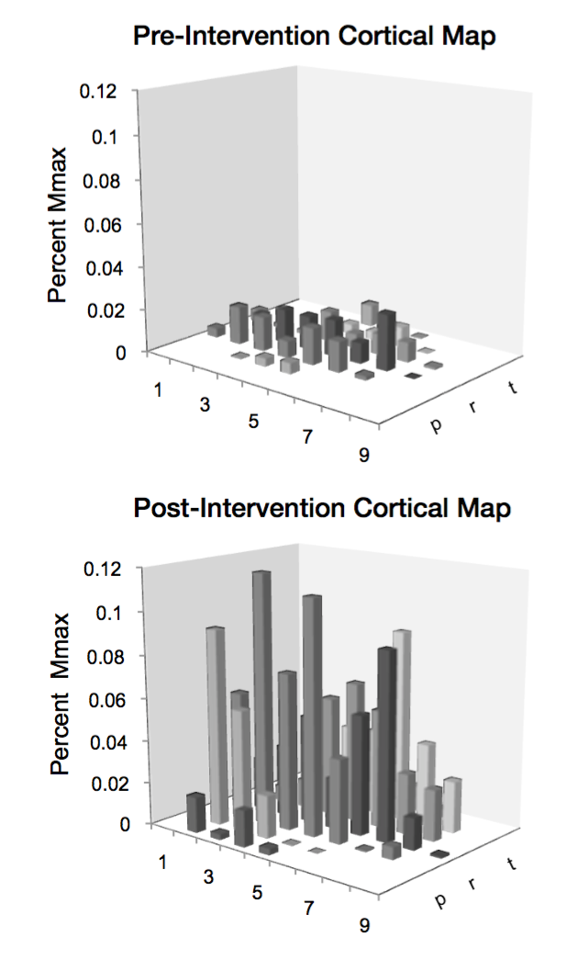
Reversing Maladaptive Cortical Plasticity of Thenar Muscles in Persons with SCI
Pre-Intervention
Post-Intervention
Hoffman & Field-Fote, Top Spinal Cord Rehabil, 2013
Notes:
Hoffman 07: case report of individual with chronic (1 year post-injury), C6 neurological level of injury, AIS B; bimanual massed practice training in conjunction with somatosensory stimulation, for 2 hours a day, 5 days a week, for 3 weeks. The somatosensory stimulation was applied to only the right hand (trains were delivered at a frequency of 1 Hz, where one train consisted of 5 pulses of 1-millisecond in duration, at a frequency of 10 pulses per second, with a stimulus intensity just below that which evoked an observable twitch in any of the muscles innervated by the median nerve).
Hoffman 13: 24 participants: C7 or above, chronic injury (at least 1 year post injury), activation of thenar muscles (measured through manual muscle testing), and ability to perform at least 2 items on the JTHF or Chedoke Arm and Hand Activity Inventory (CAHAI); 5 days per week, 2 hours per day, for 3 weeks; participants received trains of stimulation, set below motor threshold with a long pulse width. Each train comprised 5 single pulses of 1 millisecond duration at 10 Hz. The intensity was set below motor threshold, which elicited no hand movement or visible muscle twitches (approximately 1-2 milliamps) and therefore did not interfere with MP

Slide 27
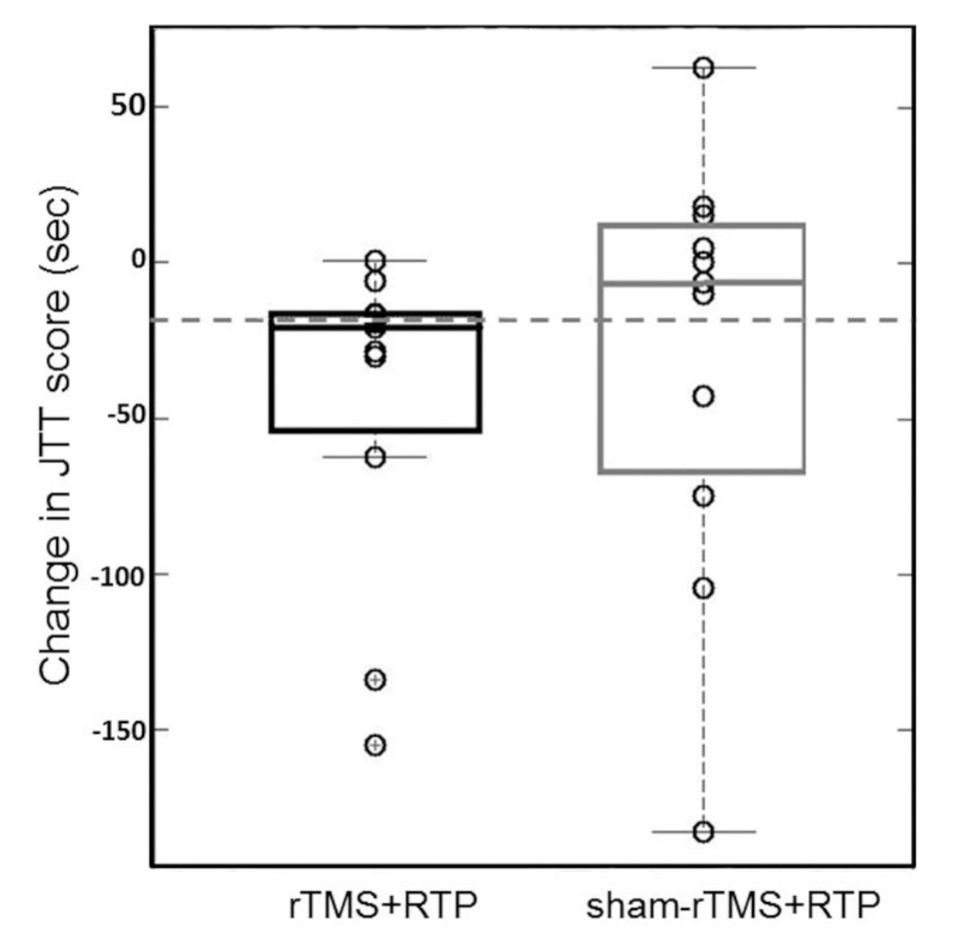
Cortical Stimulation Improves Motor Function
minimal clinically important difference
Gomes-Osman & Field-Fote, J Neurol Phys Ther, 2015
Notes:
A total of 800 pulses of 10 Hz rTMS with intensity set at 80% of the biceps RMT were delivered in 2-sec trains of 40 pulses, with an inter-train interval of 30 seconds, during which participants practiced a fine motor task (the Nine-hole Peg Test [NHPT]) in both the rTMS and sham-rTMS phases (~11 min stim)
Boxplots indicating median pre-post change in JTT time (± lower and upper quartiles) per condition (rTMS+RTP=black box) and sham-rTMS+RTP (grey box) and the minimal clinically important difference (MCID) (dotted horizontal line). Note that the median pre-post change for the rTMS condition met the MCID.

Slide 28
NIBS Studies in SCI Research:
Recruitment Completed

Slide 29
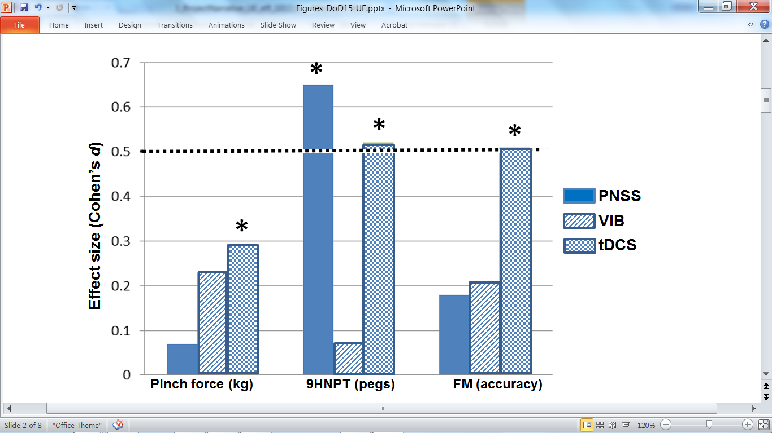
Conditioning Neural Circuits to Improve Upper Extremity Function
Background:
A single 30 minute session of cortical stimulation has a greater effect on upper extremity function than peripheral nerve stimulation when paired with fine motor training
moderate
effect
Pinch force (kg)
9HPT (pegs)
FM (accuracy)
Gomes-Osmann & Field-Fote, Clin Rehabil, 2015
Notes:
Population:
Chronic, cervical SCI
Design:
Randomized crossover
Intervention:
Single 30-min session
Clinically accessible stimulation + upper extremity massed practice
Transcranial direct current stimulation is associated with meaningful effects in a broad range of outcome measures. Short-term (30-minutes post stimulation) persistence of effects on pinch force (solid bars), Nine-hole Peg Test (9HPT; diagonal shading), and pinch force modulation (FM; checker shading) were assessed following a single session of either peripheral nerve somatosensory stimulation (PNSS), vibration (VIB), and transcranial direct current stimulation (tDCS) combined with FTP. PNSS was associated with significant effects on 9HPT. TDCS was associated with significant effects on all measures. Asterisks (*) indicate significant effects (p < 0.05). The dashed line indicates threshold for moderate effect size, which the literature suggests may be more important than p-values for assessment of clinical meaningfulness. Note that these results are from a proof-of-concept study wherein the interventions were applied in single sessions separated by one week, more definitive studies are needed. From Gomes-Osman & Field-Fote, 2015.
'Effect size' is simply a way of quantifying the size of the difference between two groups. The effect size is just the standardised mean difference between the two groups (difference of the means divided by standard deviation).

Slide 30
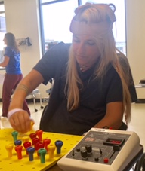
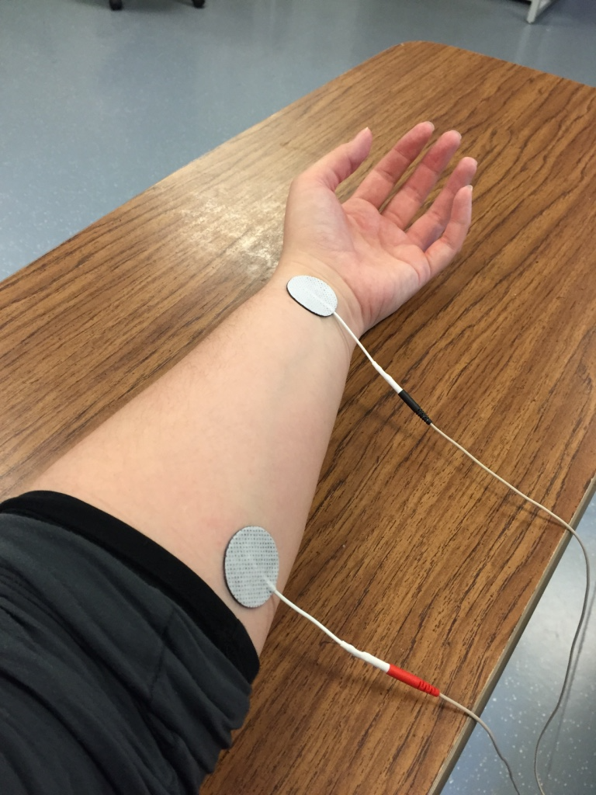
Conditioning Neural Circuits to Improve Upper Extremity Function
Purpose:
To examine how well people with tetraplegia are able to use their arms and hands after receiving fine motor training (FMT) combined with stimulation to increase brain excitability either directly or indirectly
Direct brain stimulation:
Transcranial direct
current stimulation
Indirect brain stimulation:
Peripheral nerve
somatosensory stimulation

Slide 31
Conditioning Neural Circuits to Improve Upper Extremity Function
Design
Randomized controlled trial: each participant is randomly assigned to one of three groups: tDCS + FMT, PNSS + FMT, or sham tDCS + FMT
Week 1:
baseline testing & participant stratification
Week 6:
post-intervention testing
Weeks 2-5: Intervention (3x/week)
PNSS, tDCS, or sham tDCS +
functional task practice (FMT)
Week 10-12:
single follow-up testing session

Slide 32
Conditioning Neural Circuits to Improve Upper Extremity Function
Outcome Measures:
UE motor impairment and function
UE strength and sensation
Participant perception of function/participation
Participant perception of quality of life
Corticospinal excitability
Spinal reflex excitability

Slide 33
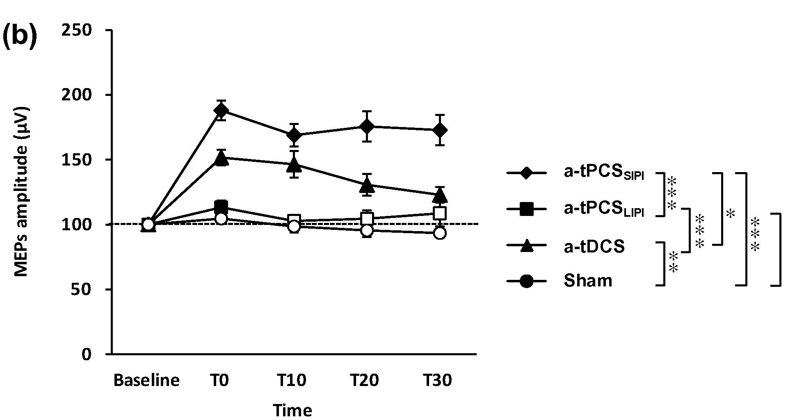
Enhancing Corticospinal Excitability to Improve Functional Recovery
Background:
Pulsed current stimulation (tPCS) increases cortical excitability more than direct current stimulation (tDCS)
Bihemispheric stimulation increases bimanual task performance
Jaberzadeh et al., Clin Neurophysiol, 2014
Notes:
Total charge(= current density (intensity/electrode size) x duration) matched between stimulation conditions: ~17 C/cm2; intensity & duration varied to match current density between conditions
Top: tPCS Pulse duration: 500 ms
randomized sham-controlled cross-over design with 72 hours of washout period was used in this study

Slide 34
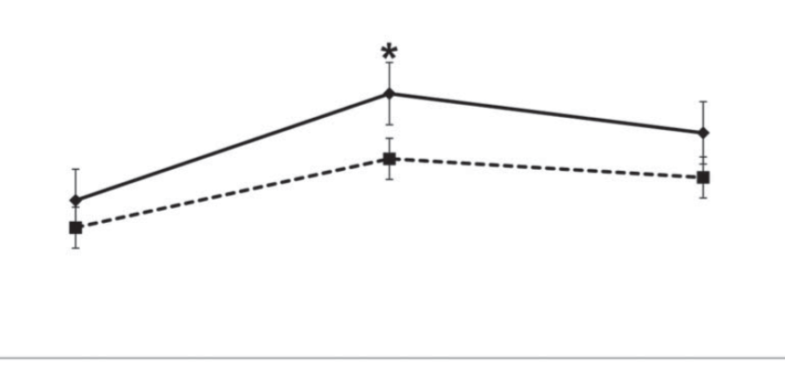
Enhancing Corticospinal Excitability to Improve Functional Recovery
Background:
Pulsed current stimulation (tPCS) increases cortical excitability more than direct current stimulation (tDCS)
Bihemispheric stimulation increases bimanual task performance
60
50
40
30
Average BT score (points)
20
10
Pre
Post
Follow-up
Bihemispheric a-tDCS
Sham tDCS
Adapted from: Gomes-Osman & Field-Fote, J Mot Behav, 2013
Notes:
Change in scores for the assessment of acquisition and retention for the bimanual typing (BT) task by group (solid line = bihemispheric anodal corticomotor transcranial direct current stimulation [BAC-tDCS], dashed line = sham-tDCS). Magnitude of change in scores between pre-Day 1 and post-Day 5 was significantly different between the 2 groups (∗p = .04, for comparison between pre-Day 1 and post-Day 5). This was not retained at follow-up (one week after cessation of stimulation and practice).
Subjects (28 non-injured) underwent five consecutive days of either BAC-tDCS or sham-tDCS. TDCS was delivered by two constant current stimulators (Phoresor, Iomed Inc., Salt Lake City, UT) for which the output of the device was concealed from the subjects. Intensity was set at 1 mA, according to safety guidelines (Bikson, Datta, & Elwassif, 2009). Four saline-soaked, disposable iontophoresis elec- trodes (Optima, Iomed Inc, Salt Lake City, UT) were used for the stimulation: two active (anodal) electrodes with an area of 28 cm2 each were placed on the scalp over the hot spot (result- ing in a total current density of 35 μA/cm2), and two reference electrodes were placed on the supraorbital area bilaterally. The area of the inactive electrodes was approximately 37 cm2. The duration of the BAC-tDCS and the sham-tDCS period was 20 min each day.

Slide 35
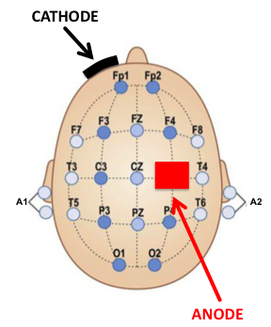
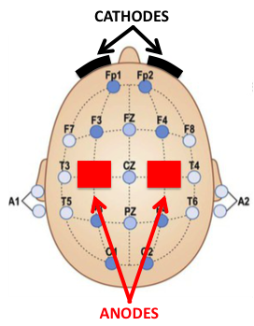
Enhancing Corticospinal Excitability to Improve Functional Recovery
Purpose:
To compare four different stimulation conditions for increasing brain excitability to determine which is best for helping people with tetraplegia improve their ability to use their arms and hands
tDCS
monophasic, continuous
tPCS
monophasic, pulsed
unihemispheric
bihemispheric

Slide 36
Enhancing Corticospinal Excitability to Improve Functional Recovery
Design:
Randomized crossover trial
Each subject participates in a single session of each stimulation type
Outcome Measures:
Motor Control – timed tapping task
Dexterity – nine hole peg test (9HPT)
Strength – key pinch force
Corticospinal excitability – motor evoked potentials

Slide 37
NIBS Studies in SCI Research:
Current & Upcoming

Slide 38
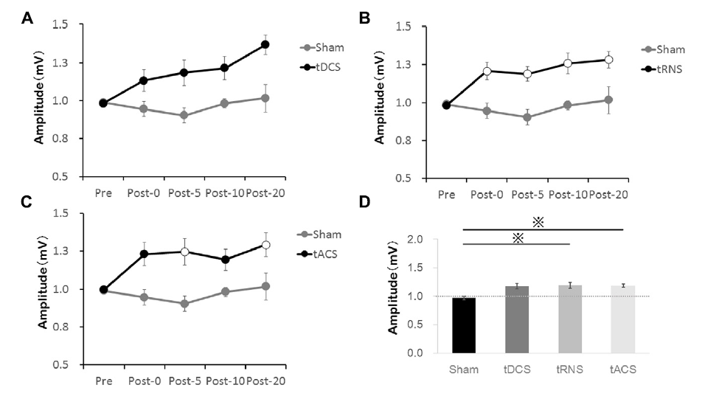
Random Noise to Enhance Corticomotor Drive for Improved Hand Function
Background:
Random noise (tRNS) has increased tolerability and no risk of burns.
Random noise stimulation (tRNS) increases cortical excitability more than direct (tDCS) and alternating current stimulation (tACS).
Adapted from: Inukai et al, Front Hum Neurosci, 2016

Slide 39
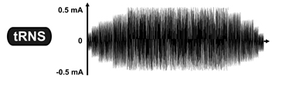
Random Noise to Enhance Corticomotor Drive for Improved Hand Function
tRNS
Purpose:
To compare the effects on cortical excitability, motor and sensory function of 3- day combined tRNS + fine motor training protocol to tDCS + fine motor training and to sham-stimulation + fine motor training protocols in individuals with tetraplegia.
biphasic, random
tDCS
monophasic, continuous
unihemispheric

Slide 40
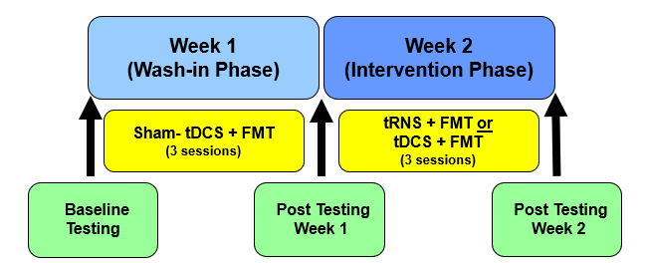
Random Noise to Enhance Corticomotor Drive for Improved Hand Function
Design:
Outcome Measures:
Cortical Excitability- Motor Evoked Potentials
Unimanual Function- Grasp and Release Test
Bimanual Function- CAHAI_9
Sensory Function- Sensation subtest of GRASSP &
revised Nottingham Sensory Assessment
Strength- Pinch and Grasp strength

Slide 41
Enhancing Corticospinal Activation for Improved Walking Function
Purpose:
Determine if moderate-intensity, circuit training can improve walking-related outcomes
Determine if the addition of non-invasive brain stimulation will result in greater improvements in function compared to circuit training alone
tDCS
monophasic, continuous
ANODE
CATHODE

Slide 42
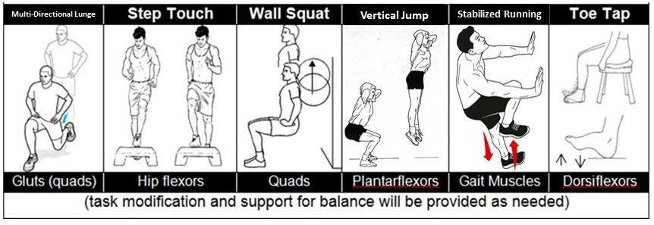
Enhancing Corticospinal Activation for Improved Walking Function
Design:
Randomized controlled trial
Each participant is randomly assigned to one of two groups: tDCS + training OR sham tDCS + training
Outcome Measures:
Walking Function
LE strength
Balance
Spasticity
Functional Strength
CIRCUIT TRAINING
Note: Task modification and balance support provided as needed

Slide 43




Acknowledgements
Edelle Field-Fote, PT, PhD
Allison McIntyre, MOT, OT/L, CCRP
Barry McKay, BS
Beth Sasso, PT, DPT, NCS
Brandon Poe, MPA, CCRP
Cathy Furbish, PT
Cazmon Suri, MS
Evan Sandler, PT, DPT
Jasmine Hope, BS
Kyle Condon, PT, DPT
Marissa Mirecki, MOT, OTR/L
Nick Evans, MHS, ACSM, CEP
Ryan Koter, PT, DPT
Sarah Callahan, MOT, OTR/L
Stephen Estes, PhD
Hulse Spinal Cord Injury Lab

Slide 44
Questions?

